Slide 1
Football Events Dataset
Information Visualization Term Project
Presentation Video Link: Presentation
Live App: Website
Prem Banker
premb@vt.edu

Slide 2
Football Events Dataset Information
All the events of Football games from the top 5 football leagues i.e. English, Spanish, German, Italian and French.
>9,00,000 data points
Dataset consists of 2 files:
Events.csv
Data points giving information about all the event in a game i.e. Goal, Assist, Save, Interceptions, Tackles, Key Passes, etc.
Contains detailed data which could be used for individual player analysis, counting player and team stats, advanced metrics and also play-styles of players and teams.
Ginf.csv
Match outcomes and pre-match odds of all the games.
Used to calculate top-level team stats, different play-styles by countries and progression of football throughout years.

Slide 3
Aims
To understand the differences about how football has evolved across different leagues over this time period.
Teams which have excelled and teams who have underperformed.
Play-styles of different teams by calculating the defensive and offensive metrics and measuring the team’s performance against the “normal”
Create visualizations for counting stats (goals, assists) and other team and individual player stats.
Play-style of teams against each other i.e. how a defensive team plays against an offensive team and vice versa.

Slide 4
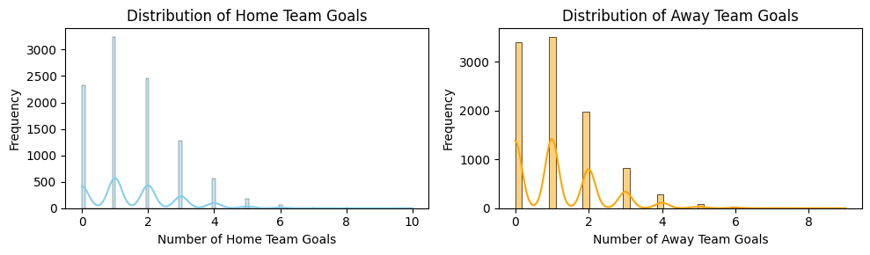
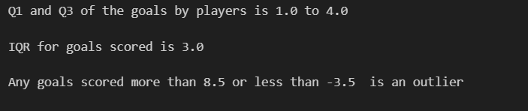
Some Statistical Analysis

Slide 5
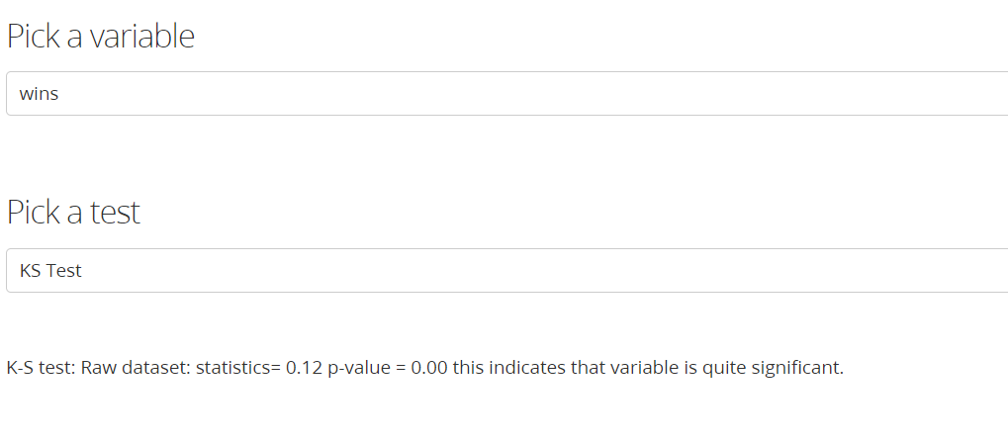
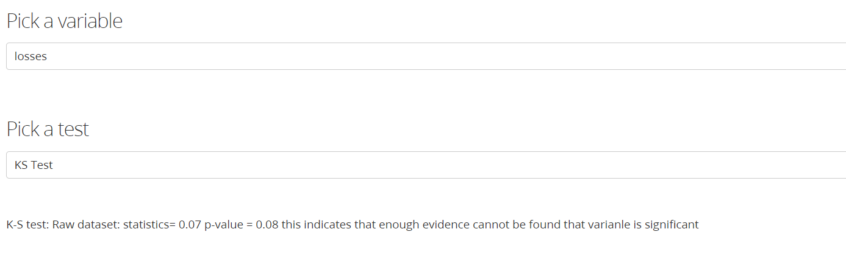
Normality Test

Slide 6
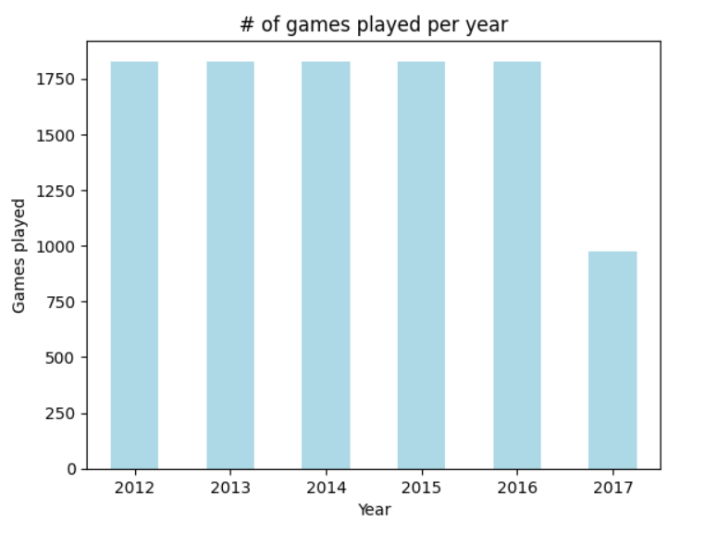
Questions: What period of games are we dealing with ?

Slide 7
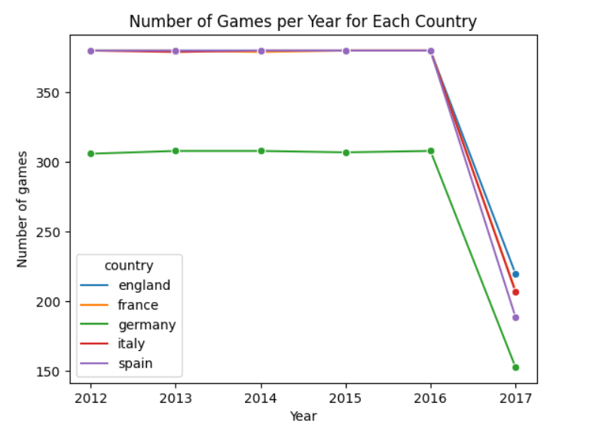
What is the game distribution across different countries ?

Slide 8
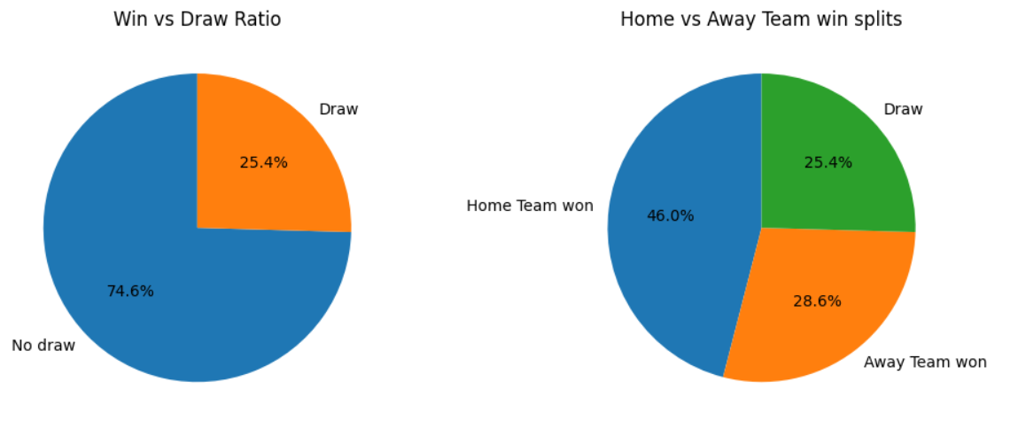
How many games end up being draw vs having a win-loss outcome ?

Slide 9
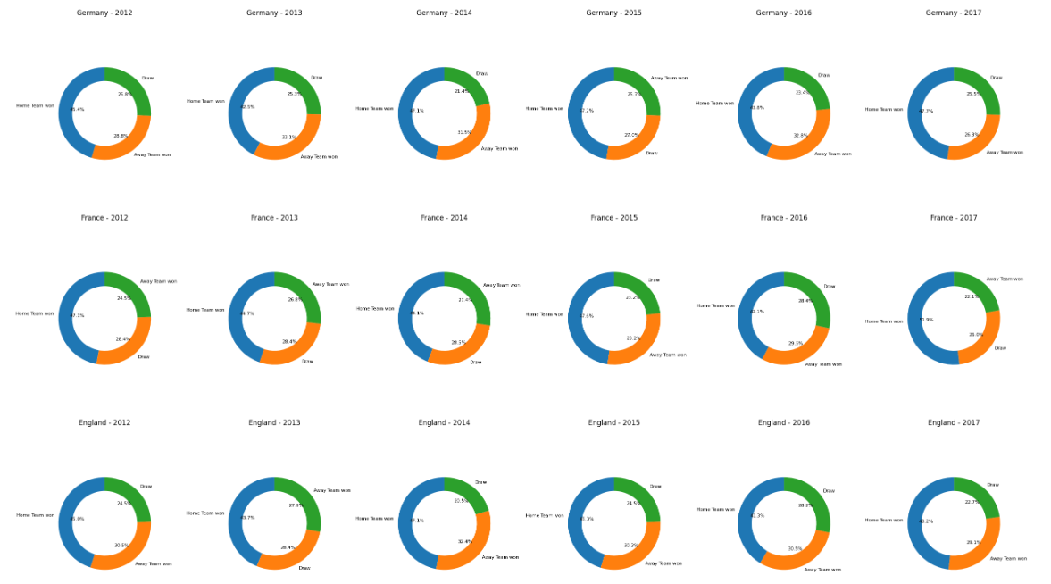
Any outliers in these percentages ?

Slide 10
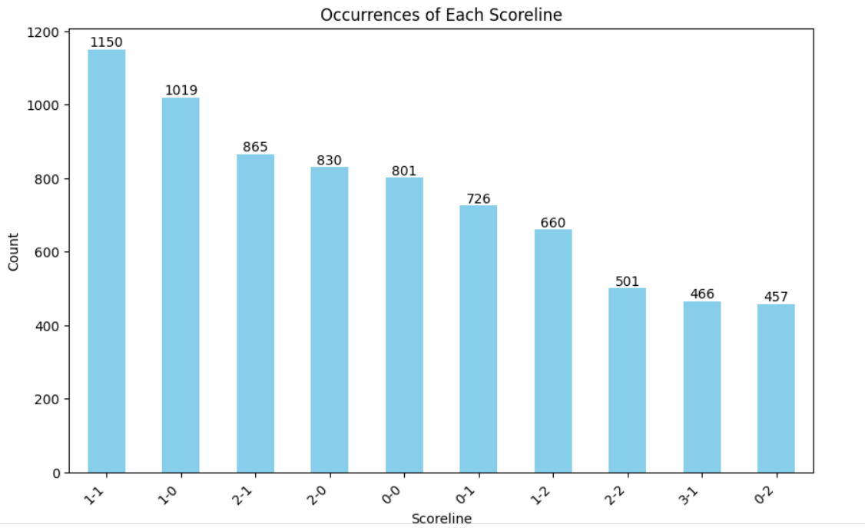
What are the most common score lines ?

Slide 11
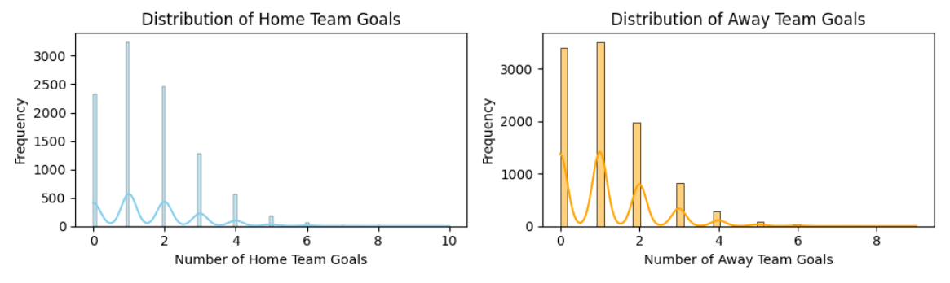
How many goals does a Home team score vs an Away team

Slide 12
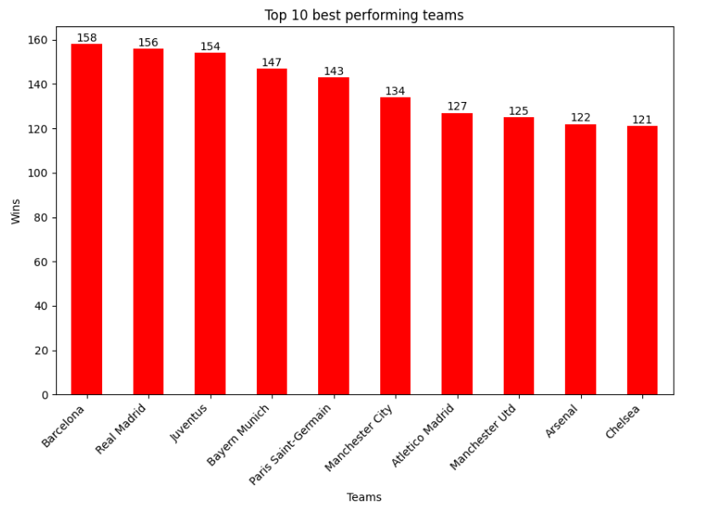
Which are the best performing teams ?

Slide 13
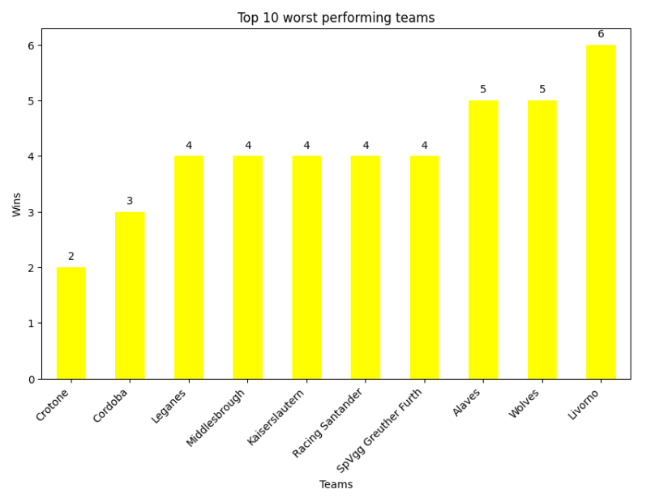
And the worst performing teams ?

Slide 14
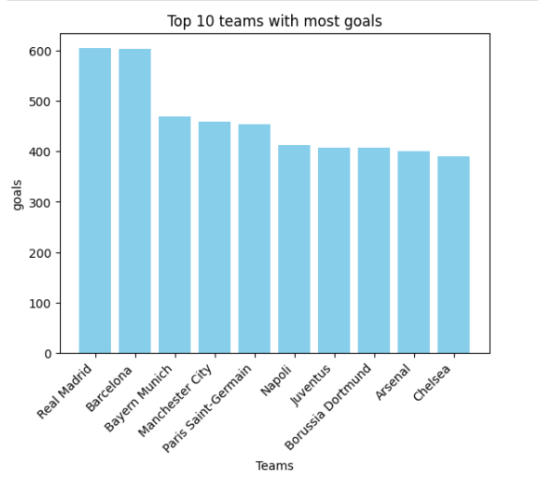
Which is the most attacking team ?

Slide 15
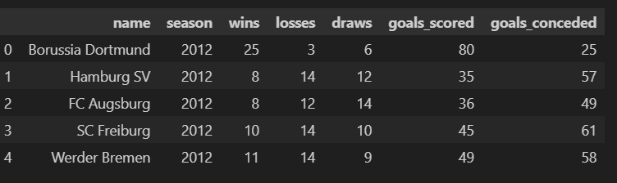
Morphing to Team Seasons Dataframe

Slide 16
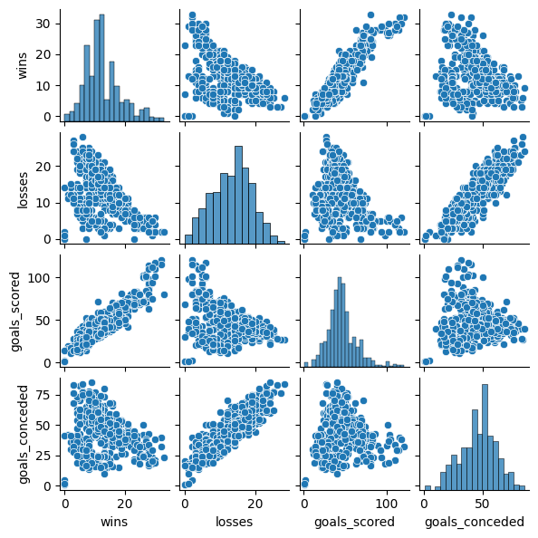
Pair plots

Slide 17
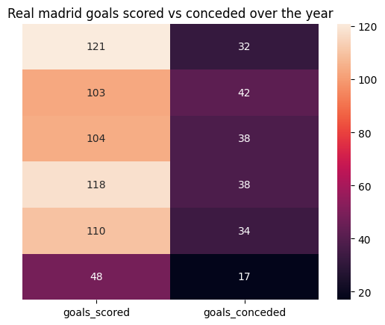
Case Study: Real Madrid Goals Scored vs conceded

Slide 18
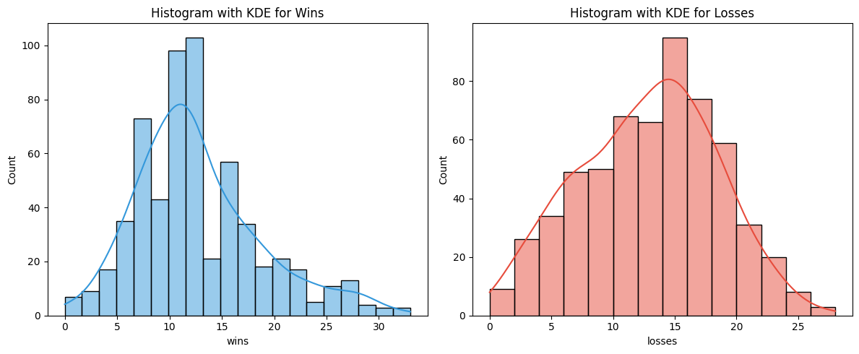
Hist plot with KDE

Slide 19
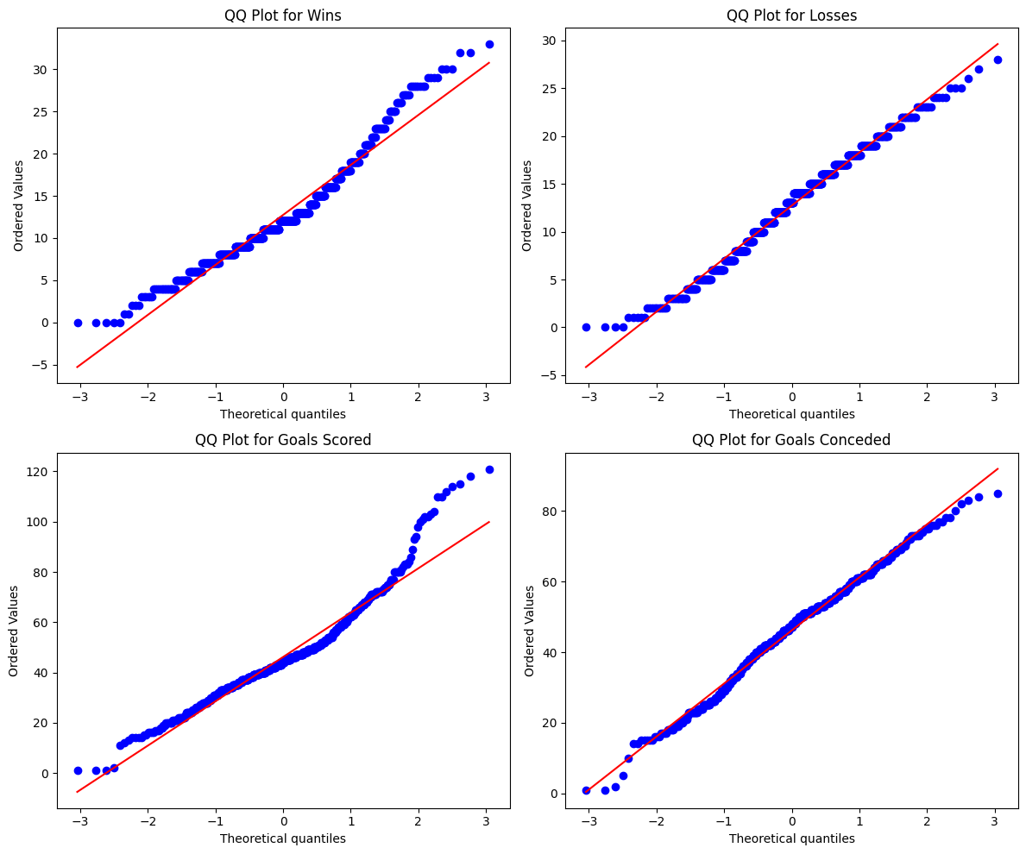
QQ Plots

Slide 20
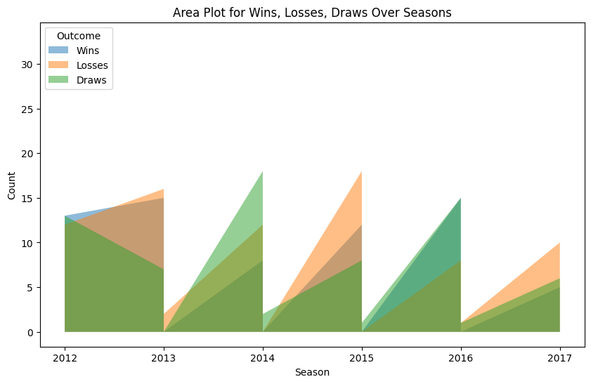
Area Plot Analysis

Slide 21
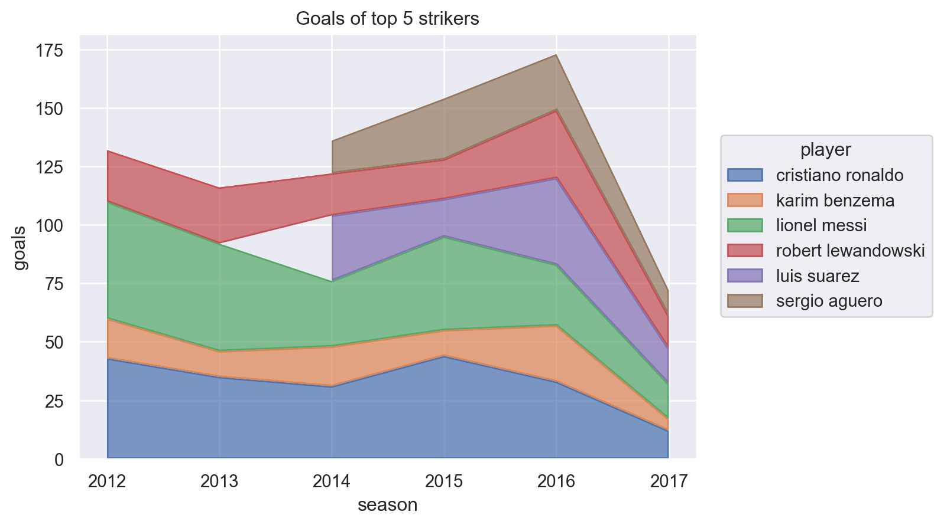
Area plot: Goals of Top Strikers

Slide 22
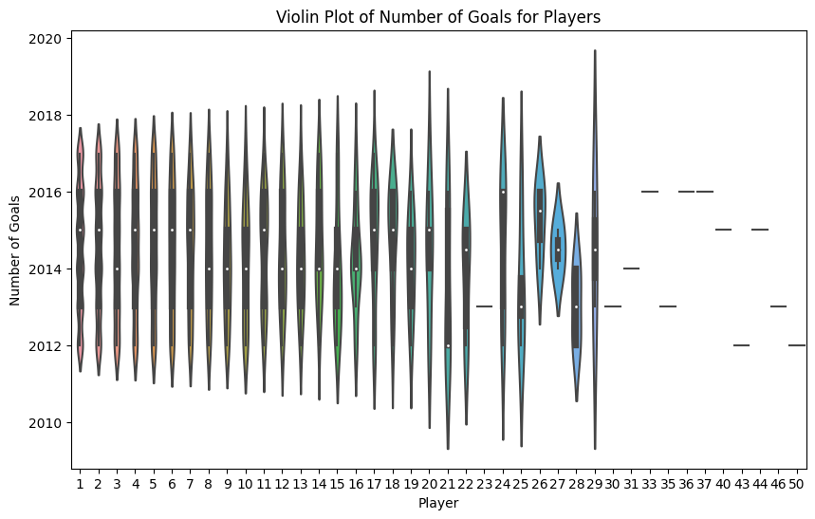
Outlier Detection through Violin plot

Slide 23
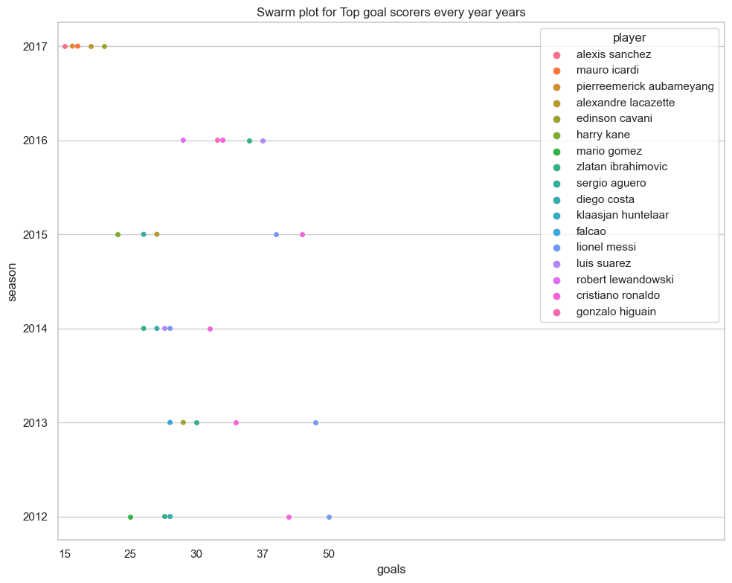
Swarmp Plot

Slide 24
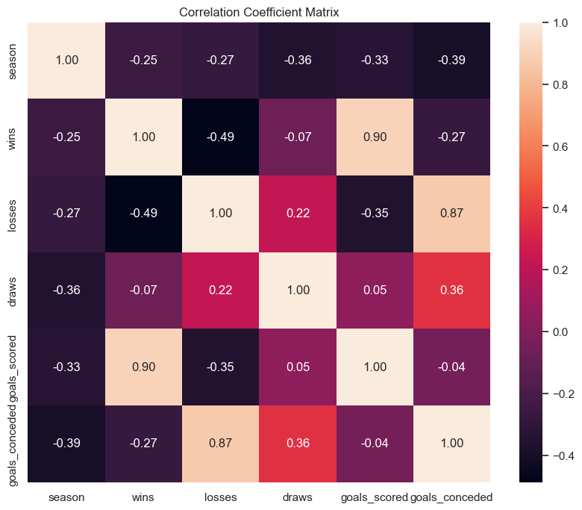
Correlation Coefficient Matrix

Slide 25
Some Phase 2 plot
The Main aim for Phase 2 plots was to let users have interactivity and let them discover stats on their own.
Be it their favourite team and their favourite players, users would be able to find interesting stats and compare their favourites against each other.
Live App can be found here.

Slide 26
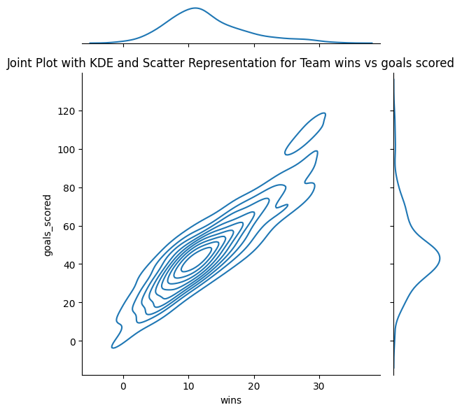
And some more plots: Joint Plot with KDE

Slide 27
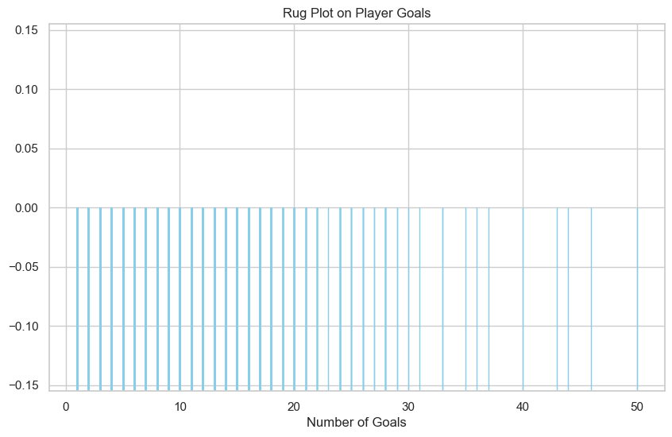
Rug Plot

Slide 28
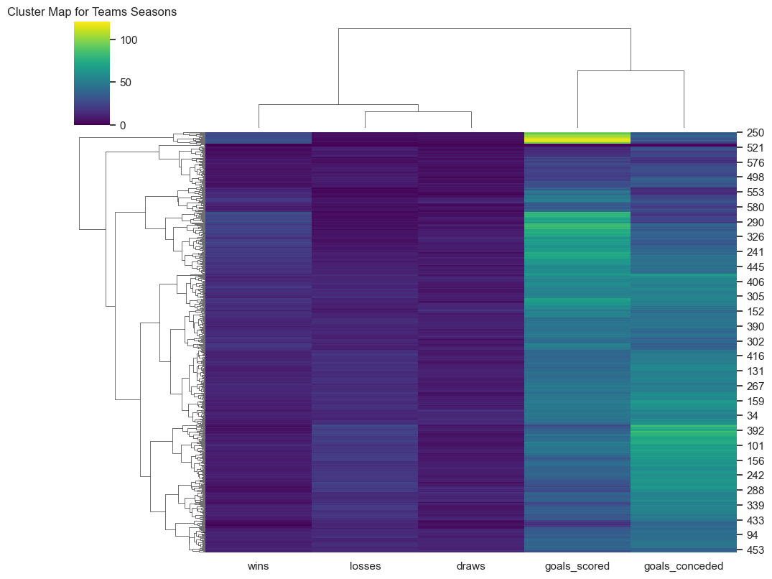
Cluster Map

Slide 29
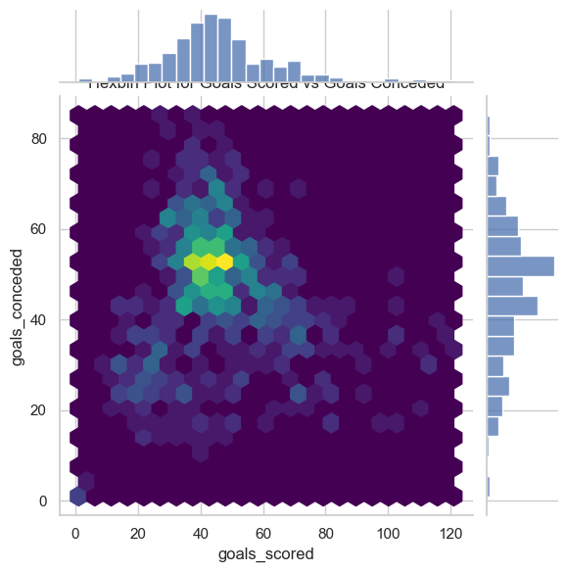
Hex Bin

Slide 30
Conclusion
Learnt a lot about different python packages
Best ways to handle different types of data
Create your own data
How to use different types of graphs for different types of visualizations

Slide 31
Thank you

